Slide 1
CLOUD COMPUTING: *-AS-A-SERVICE

Slide 2
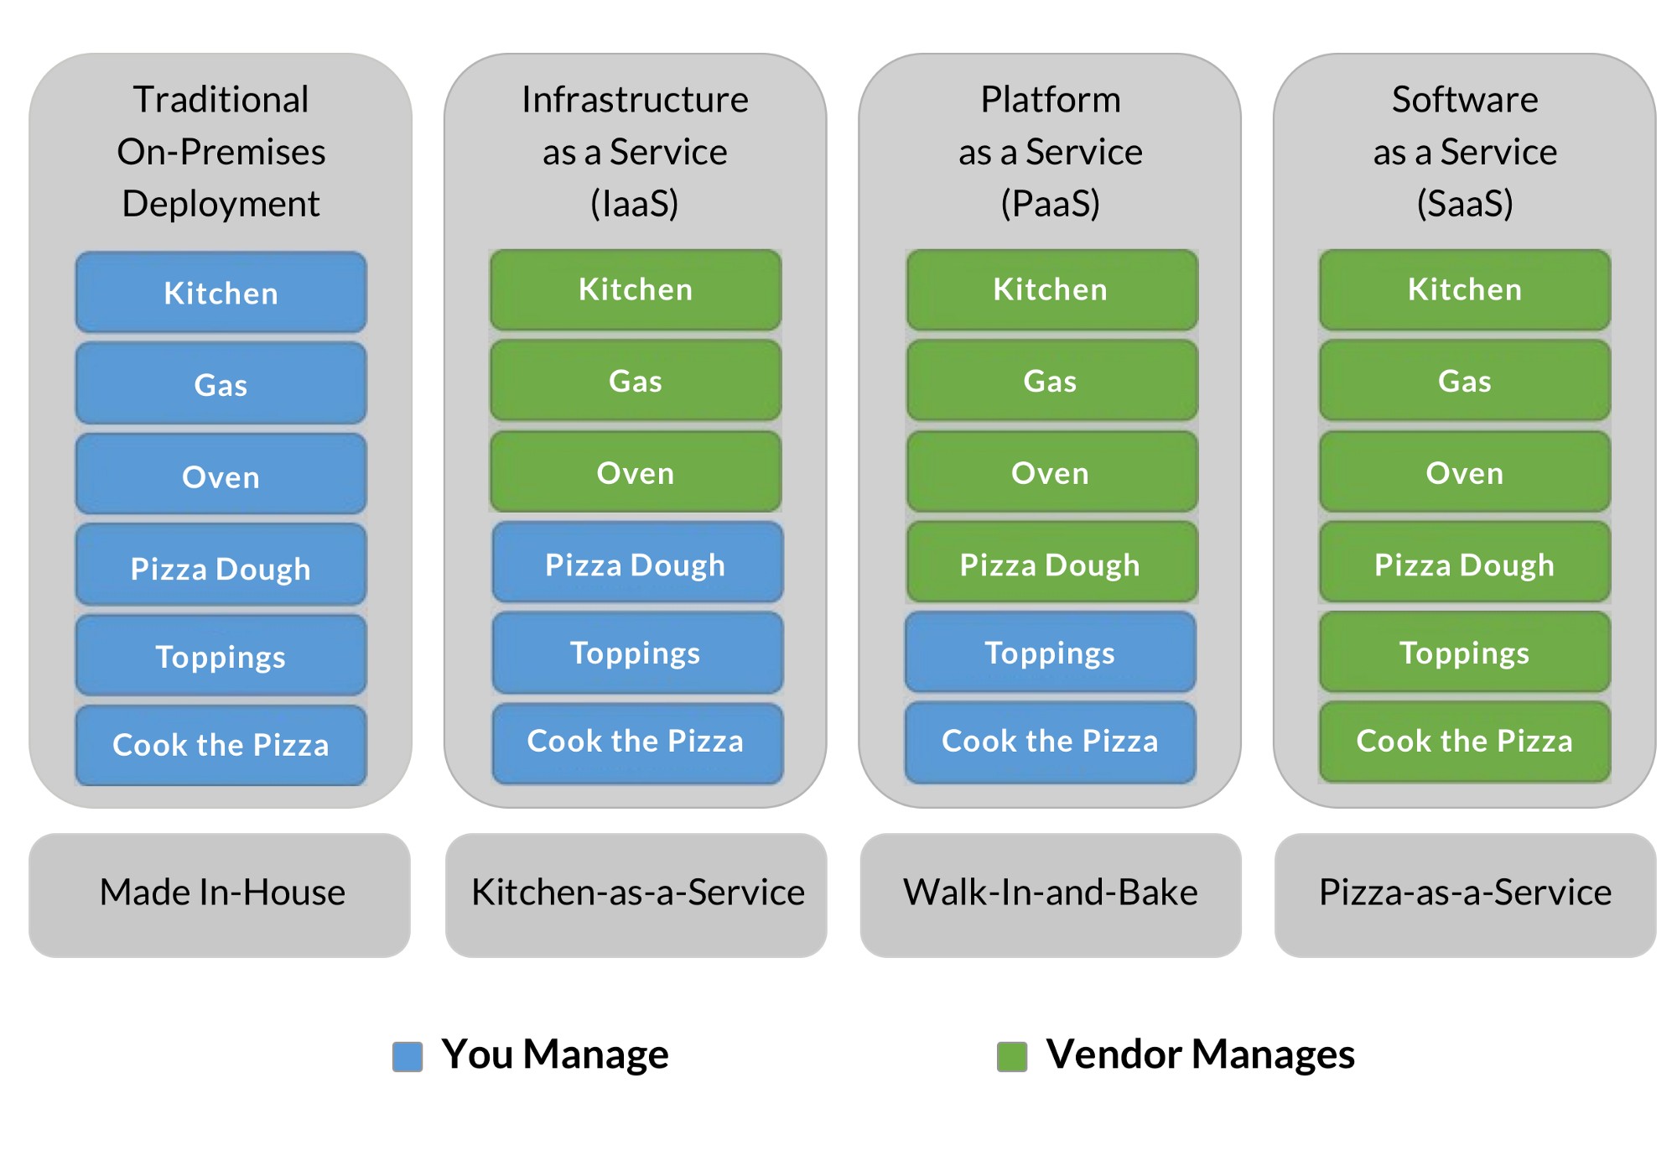
Lesson Objectives
Discuss the service models of IaaS, PaaS, and SaaS
Select an appropriate service model for a given use case.

Slide 3
Infrastructure as a Service
https://www.serverwatch.com/reviews/iaas-providers/

Slide 4
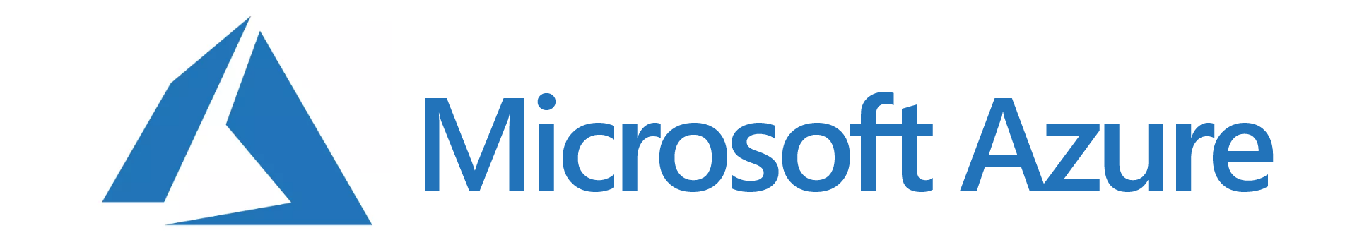
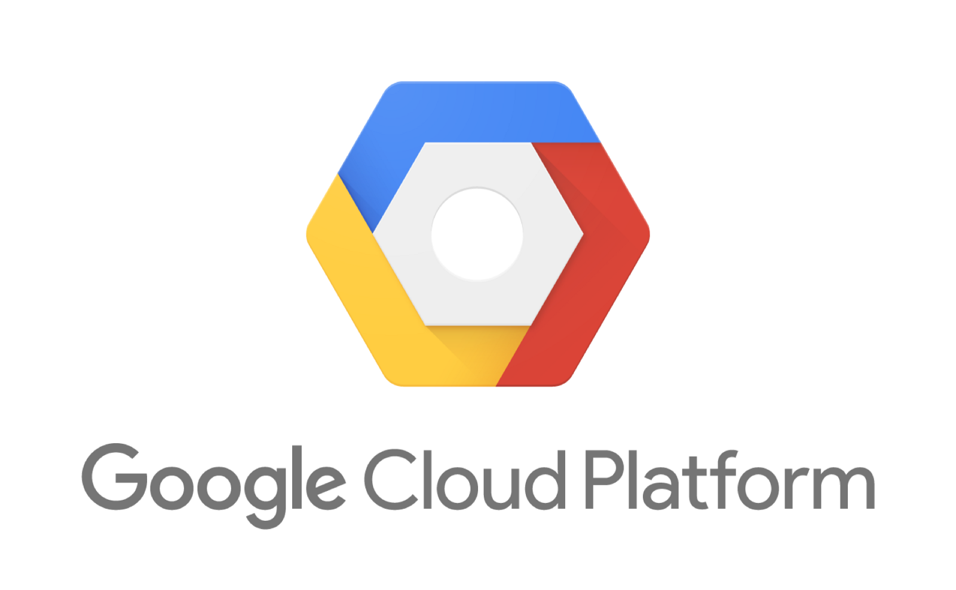
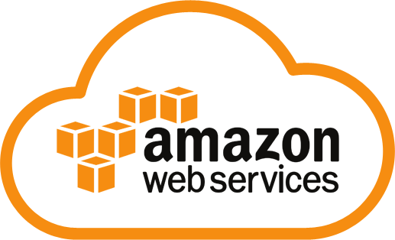
Infrastructure as a Service
First cloud service model available
Incremental on demand deployment and billing
Deployed with self-service on-demand portals
Detailed measurements and reporting help for scaling up or down
No upfront costs
Pay for what you need
Build your services from the OS on up

Slide 5
IaaS: Where to begin?
Define the problem you are solving
Choose your OS
Choose your Services
Determine how much resources you need
Find an IaaS Provider
Provision Service
Setup virtual machine instances
Run your Service!

Slide 6
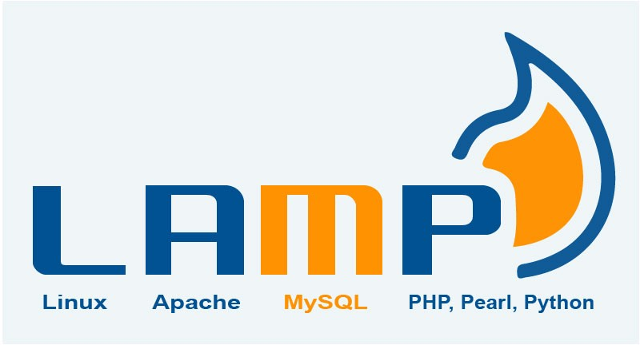
In Class Scenario #1
Is IaaS your only option?
If you are going with IaaS, how many servers do you need?
What OS are you planning to use?
You are planning to create a LAMP stack (Linux, Apache, Mysql and PHP) to run a Wordpress site. There are a multitude of options in making this work. You expect approximately 1k users when you get it up and running.

Slide 7

In Class Scenario #2
If you have 6 virtual machines in the lab, how long will it take to finish in-house (in days)?
In order to accomplish the lab’s goals, you need it completed in 5 days. How many VMs will you need to provision to complete in this amount of time?
You are working in a research lab and your team plans to run a simulation that will produce four terabytes of data and require approximately 2000 hours of compute time on a vm computer.
Notes:
2000/6 = 333.3 hours per machine. 13.8 days ~14 days total
5*24 = 120 hours to complete. 2000/120 = 16.6 servers, so 17 servers would be able to complete in just less than 5 days
I/O clarify

Slide 8
Platform as a Service
https://www.trustradius.com/platform-as-a-service-paas

Slide 9

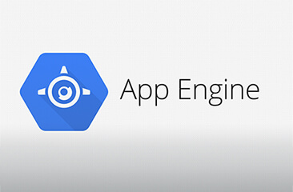
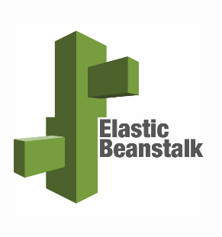
Platform as a Service
Provides Execution Runtime Environment
Multi-tenant environment (Savings!)
Underlying functions and components shared between apps (i.e. Databases)
Use an IDE for development, and then deploy!
Use Git on Heroku to push code for deployment
Notes:
Platform-as-a-Service (PaaS) is an execution runtime environments offered in a multi-tenant environment. The underlying assumption is that applications often use similar functions and that these components can be shared with other applications. Sharing this common functionality should also result in higher environment utilization rates.Common application functionality is offered in an execution environment that delivers platform libraries for custom application implementations using middleware solutions. The most common of these are databases and integrated development environments (IDEs).

Slide 10
PaaS Considerations
Languages and Frameworks
Applications are never static
Redeployment across different hosting environments
Proprietary and unique workflows (including testing)
Application Programing Interface (APIs)
Is it RESTful, and what does this mean?
What is SOAP?
JSON
Provider flexibility, Platform flexibility, migration options
Notes:
REST Representational State Transfer… HTTP Methods: GET, HEAD, POST, PUT, PATCH, DELETE, CONNECT, OPTIONS and TRACE
Simple Object Access Protocol (SOAP)
REST is a method and SOAP is a protocol
Javascript Object Notation

Slide 11
Example Web Applications that can be deployed to PaaS
Ruby on Rails (Model-View-Controller web application framework)
Flask (Python)
Django (Python MVC)
CakePHP (PHP MVC)
Laravel (PHP)
ASP .NET Core
Sails.JS (runs on Node.JS)

Slide 12
In Class Scenario #3
You are developing a Ruby on Rails application and want to test it out for free.
What PaaS service exists that has a “free” tier that may work? (search on the internet now if you need too)
How much does it cost if you want to put it in “real” production mode?

Slide 13
In Class Scenario #4
You have developed a cool machine learning tool in python and it is currently a standalone program. You want to have multiple people access this program, and you want to collect data from the people accessing it so you can optimize and/or validate the algorithm. You decide to make it into a web application.
What web framework would you choose?
What PaaS system will support the framework you have chosen?
What will the pricing model be for this application?

Slide 14
Software as a Service

Slide 15
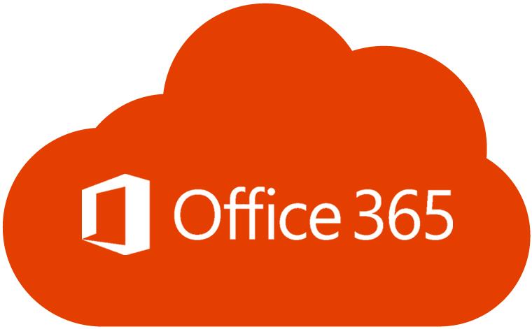
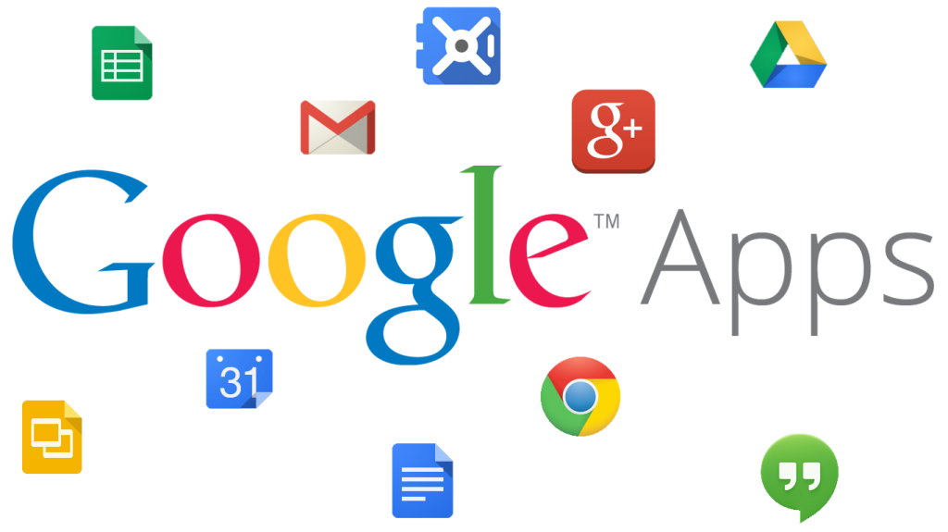


Software as a Service
Everything is provided
Office applications are most common
Examples: E commerce software, Project Management, Accounting, email marketing, billing and invoicing
Security of the system is handled by the provider
Notes:
Platform-as-a-Service (PaaS) is an execution runtime environments offered in a multi-tenant environment. The underlying assumption is that applications often use similar functions and that these components can be shared with other applications. Sharing this common functionality should also result in higher environment utilization rates.Common application functionality is offered in an execution environment that delivers platform libraries for custom application implementations using middleware solutions. The most common of these are databases and integrated development environments (IDEs).

Slide 16
SaaS Considerations
Cost Control, cost reduction
Licensing is a subscriber model as opposed to licensing the software
Provider can handle support at scale
Improved security
Standardization and compatibility
Global Accessibility
Economy of scale provides many of these benefits
Notes:
Using SaaS, organizations have potentially limitless possibilities for running applications that may not have been otherwise possible given the limitations of their corporate systems, infrastructure, or resources. If the right middleware and associated components are deployed, SaaS can present massive incentives and benefits. Organizations can quickly realize benefits from scalability, flexibility, and on-demand self-service capabilities. Customer adoption accelerates as access to data and applications can be from virtually anywhere, at any time with internet access. Additional benefits include:
Cost control, cost reduction
Licensing or support becomes a built-in component for the provider and the subscriber benefits from economies of scale
The purchasing of up-front bulk licensing and the associated capital expenditure is removed and replaced by demand-based pay-as-you-go licensing models
User-based internal support requirements reduce significantly as the software cloud service provider can typically handle more of the support at scale
Ease of use and limited administration
Automatic updates and patch management
Improved security
Standardization and compatibility
Global accessibility

Slide 17
In Class Scenario #5
What software is available to perform office functions in the cloud (SaaS solutions)?
What are the pros and cons of going to SaaS?
How much does an O365 license cost per month per person for a business this size? (hint: search Microsoft’s site)
You just founded a startup company and currently have 10 employees and you are about to hire 20 more because business is booming.
You have 10 work laptops that have Windows and Office preloaded on them.
Based on your business growing, you decided to move to a cloud solution instead of buying more standalone office 365 licenses (estimated $150 / installation)

Slide 18
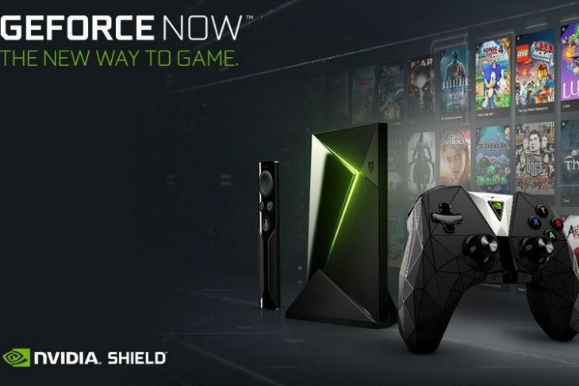

In Class Scenario #6
What is the “break even” point of buying hardware versus utilizing a GaaS. Specifically, research the monthly cost, and research how much the GPU costs that they utilize. Determine how many monthly payments (when) they add up to the cost of the GPU.
Research a Gaming as a Service (GaaS) like Stadia or Nvidia. Find how they work and details like pricing and what GPUs they utilize.

Slide 19
Overview

Slide 20
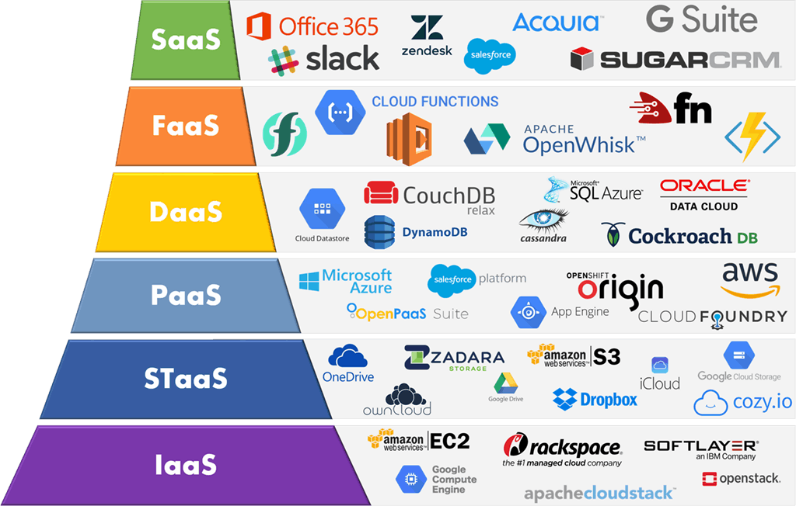

Slide 21
Questions?

Slide 22
EECSnet Exercise

